Slide 1



PROJECT MANAGEMENT IN PRACTICE
Project Risk Management
Lecture No: 12 Week: 6
Vispi Shroff
Sub Heading
And Date

Slide 2

Recap
- Importance of good communications in projects
- Stakeholders Identification and stakeholder management strategy
Elements of project communications planning
Various methods for distributing project information and the advantages and disadvantages of each,
Calculate the number of communications channels in a project

Slide 3
Today’s Topics & Learning Outcomes
Importance of Risk
Overview of the Risk Management Process
Planning Risk Management
Identifying Risks

Slide 4
Importance of Project Risk Management
- Project risk management is the art and science of identifying, analyzing, and responding to risk throughout the life of a project and in the best interests of meeting project objectives
Risk management is often overlooked in projects, but it can help improve project success by helping select good projects, determining project scope, and developing realistic estimates
Risk Management for a holiday?

Slide 5
- Risk Management has lowest maturity levels according to study by Ibbs and Kwak, compared to other PM knowledge areas
A similar survey was completed with software development companies in Mauritius, South Africa in 2003, and risk management also had the lowest maturity
KLCI study shows the benefits of following good software risk management practices

Slide 6
Knowledge Area | Engineering/ Construction | Telecommunications | Information Systems | Hi-Tech Manufacturing
Scope | 3.52 | 3.45 | 3.25 | 3.37
Time | 3.55 | 3.41 | 3.03 | 3.50
Cost | 3.74 | 3.22 | 3.20 | 3.97
Quality | 2.91 | 3.22 | 2.88 | 3.26
Human Resources | 3.18 | 3.20 | 2.93 | 3.18
Communications | 3.53 | 3.53 | 3.21 | 3.48
Risk | 2.93 | 2.87 | 2.75 | 2.76
Procurement | 3.33 | 3.01 | 2.91 | 3.33
KEY: 1 = LOWEST MATURITY RATING 5 = HIGHEST MATURITY RATING
*Ibbs, C. William and Young Hoon Kwak. “Assessing Project Management Maturity,”
Project Management Journal (March 2000).

Slide 7
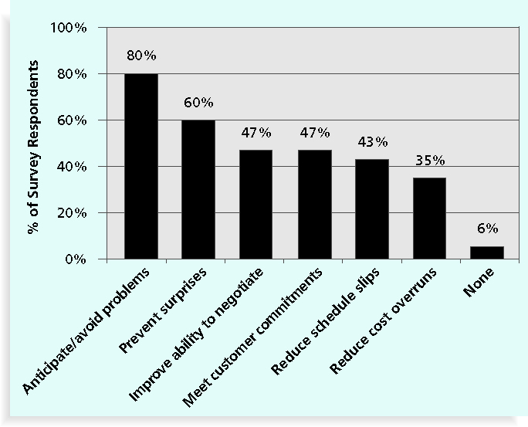
*Kulik, Peter and Catherine Weber, “Software Risk Management Practices – 2001,” KLCI Research Group (August 2001).

Slide 8
Risk – Negative or Positive
Negative risk involves understanding potential problems that might occur in the project and how they might impede project success
Negative risk management is like a form of insurance; it is an investment
Positive risks are risks that result in good things happening; sometimes called opportunities
A general definition of project risk is an uncertainty that can have a negative or positive effect on meeting project objectives
The goal of project risk management is to minimize potential negative risks while maximizing potential positive risks

Slide 9
Project Risk Management Processes
Planning Risk Management: Approach & Risk Mgmt Activities.
Identifying Risks: Determine and document characteristics.
Performing Qualitative Risk Analysis: Prioritizing risk based on probability and impact.
Performing Quantitative Risk Analysis: Numerically estimating the effects of risks on project objectives.
Planning Risk Responses: Steps to enhance opportunities, reduce threats.
Monitoring and controlling risks: Monitoring identified and residual risks, identifying new risks, creating and executing risk response plans and evaluate effectiveness of strategy.

Slide 10
Risk Management Planning
Risk Management Plan: Main output from Risk Management Planning. It should contain
Methodology
Roles and responsibilities
Budget and schedule
Risk categories
Risk probability and impact
Risk documentation
Contingency Plans: Predefined actions to undertake is risk occurs
Fallback Plans: For risks that have a high impact, and used if attempts to reduce risk are not effective.
Contingency Reserves & Allowances: Provisions to reduce effect of risk

Slide 11
IT Success Potential Scoring

Slide 12
Broad Categories of Risk
Market risk
Financial risk
Technology risk
People risk
Structure/process risk
KPMG, a large consulting firm, published a study in 1995 that found that 55 percent of runaway projects—projects that have significant cost or schedule overruns—did no risk management at all, 38 percent did some (but half did not use their risk findings after the project was underway), and 7 percent did not know whether they did risk management or not
The timing of risk management is also an important consideration

Slide 13
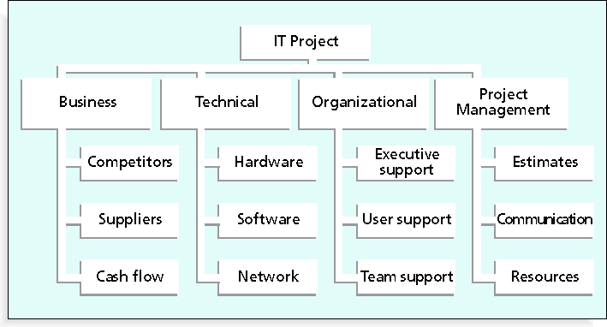
Risk Breakdown Structure
- Hierarchy of potential risk categories for a project. It’s like a work breakdown structure, but used to identify and categorise risks.

Slide 14
Identifying Risks
- Identifying risks is the process of understanding what potential events might hurt or enhance a particular project
- Risk identification tools and techniques include:
- Brainstorming – Don’t overuse it, needs experienced facilitator.
- The Delphi Technique – Used to derive consensus among panel of experts about predictions of future development. Repeated rounds of questioning and written responses.
- Interviewing - Fact-finding and structured, over various modes. Important to interview people with similar project experience.
- SWOT analysis – Helps identify broad negative and positive risks that apply to a project.

Slide 15
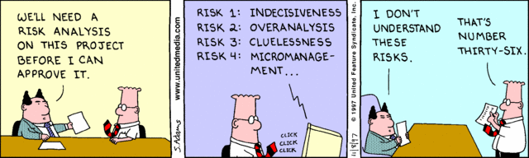
Any Thoughts, Questions, Ideas?

Slide 16
Reading Materials for the Week
Schwalbe, K., 2007. Information Technology Project Management 5th ed., United States of America: Thomson Course Technology. Chapter 11
PMBOK Guide, Chapter 11

Slide 17
Conclusions
Risk Management is important and a significant factor in reducing project failures in scope and budget.
Risks can be both, negative or positive.
Different categories of Risk
The components of a Risk Management Plan
Techniques and tools to help identify risks

Slide 18
References
Schwalbe, K., 2007. Information Technology Project Management 5th ed., United States of America: Thomson Course Technology. Chapter 11
PMBOK Guide, Chapter 11

